Slide 1

Workshop

Slide 2
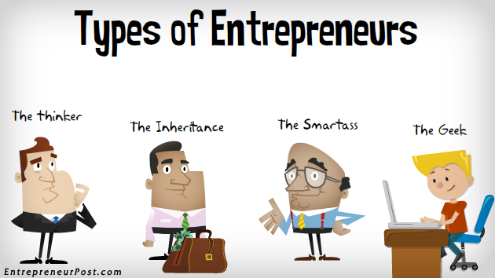

Slide 3
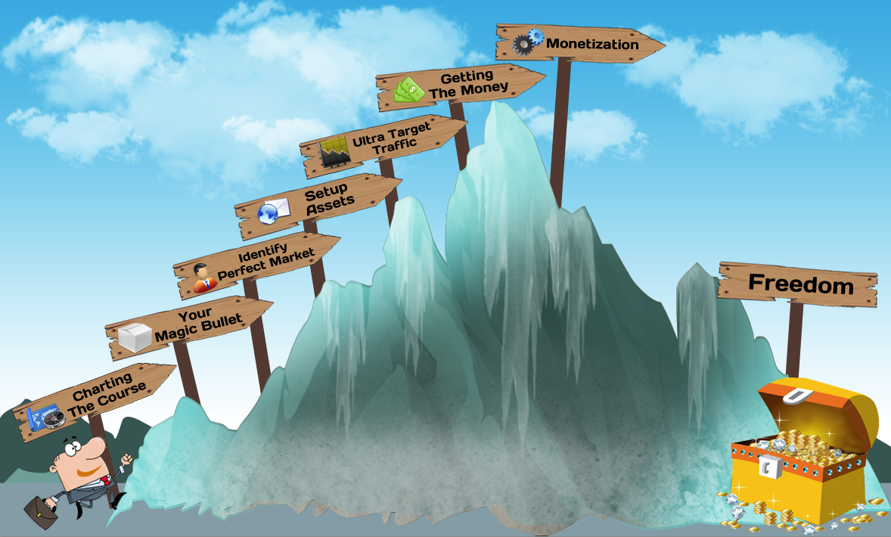

Slide 4

What are the qualities of an innovator?

Slide 5

What are the qualities of an entrepreneur?

Slide 6
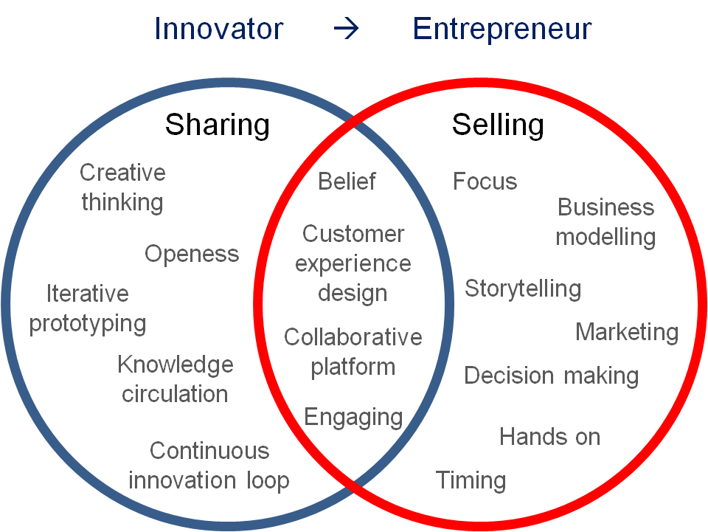
So are they same or different?

Slide 7

We need creative innovations!

Slide 8
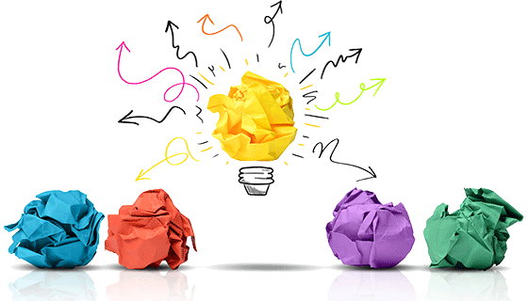
Let us view an Inclusive Business idea!

Slide 9
Small Business Ideas
Multi-Purpose Cart

Slide 10
Goal of the Small Business Group
Because wheelchair users have many hindrances in finding employment, our goal is to design a product that aids disabled users in running their own small businesses.
By enabling its user to gain more independence and self-sufficiency through earning an income and feel less burdensome to his or her family…

Slide 11
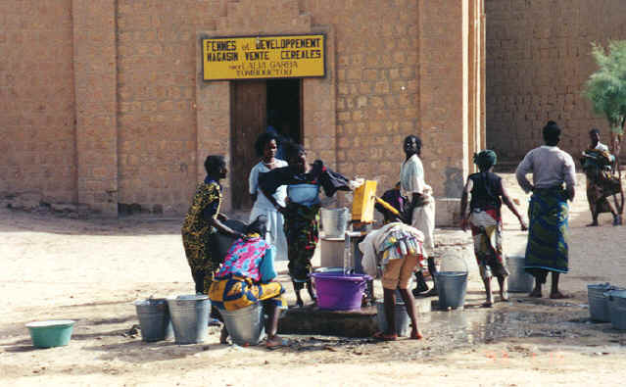
Identified Market: Water Supply
In many places in Tanzania*, water is not easily accessible or available.
Even in cities, people may travel a few miles to the nearest tap to purchase water
The purchased water must also be boiled before it is safe to drink
People are willing to purchase water for a higher price if it has come from farther away!
At a local water tap.

Slide 12
Problem: Water Transport.
How much water does a person need each day?
One adult will drink 2 ~ 3 L /day minimum. (Children can have less?)
At least one jerrican (20 L) per small family (4 people), per day.
How and where do people get water?
Terrain and distance to water source vary according to location (urban v. rural.)
Looking at a relatively flat, city-environment, (e.g.. Dar Es Salaam)…
Each day, a member of the family will have the responsibility for walking (on average) 2 km to a local water pump. The people that regulate the water pump will charge about ?? to fill up a 20 L jerrican. Water is then carried back home by hand.

Slide 13
How much time and money is spent on water acquisition?
Considerations:
Distance between home and water source. Difference between walking 2 km of flat, smooth terrain, and 2 km uphill.
2) Water availability. During water shortages, there can be a long wait (~1/2 day) at the water dispenser to receive water.
3) Who collects the water for the family. Retrieving water is often a job done by children. Depending on the age and strength, the task of carrying one 20 L ‘jerrican’ of water can be quite arduous.
Water weighs 8 1/3 lbs per gallon.
So, one jerrican (20L) filled with water weighs 20 kg, or about 44 lbs!!

Slide 14
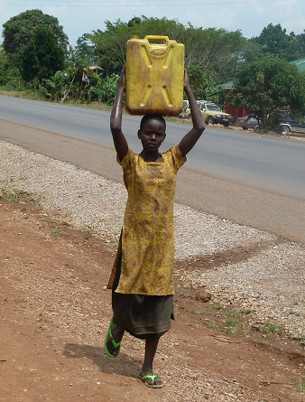
Task: To design a means for wheelchair users to transport water.
Tricycles have been spotted transporting water in Dar Es Salaam! They can accommodate up to two standard jerricans.
But, as of now… wheelchairs are not equipped with storage compartments.

Slide 15
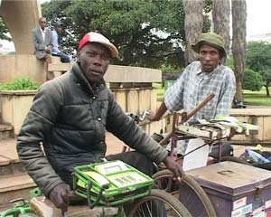
Identified Market: Call Vendor
People commonly do not own their own phone, but pay to use a phone on a per-call basis.
TTCL phones are able to run off of batteries. They use a pre-paid service.
Call vendors sit in busy areas where people know where to find them.
Using an attached tray to hold a TTCL phone to his wheelchair, this disabled man is able to earn an income.

Slide 16
Functional Requirements
Must be:
produced locally
affordable
easily moveable and transformable (able to be manipulated by the wheelchair user without assistance.)
able to safely transport at least *two 20 L jerricans of water (~ 90 lbs)
versatile- to accommodate multiple functions and carrying loads.

Slide 17
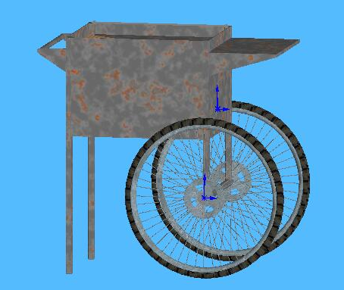
Proposed Solution: Multi-Purpose Cart
We propose this detachable cart unit that can be used for multiple small business enterprises as well as for transporting water.
Versatility of function:
lets the user select the type of small business he or she desires and is able to perform.
User can easily switch between businesses (e.g. collect water and sell vegetables)
Cart can be placed in front of merchant and function as a sales stand. (store front, desk...)
Mount for a TTCL phone
A simple hitch enables the cart to detach from the wheelchair and be self-supported.

Slide 18
Problems Solved by this Cart
Income Generation for Wheelchair users, reducing burden on families
Meeting the demand for water
Serving the customers with a essential need of safe drinking water
Removing the burden on children to carry water for the family, reducing child labor
Enabling girls / children to go to school

Slide 19
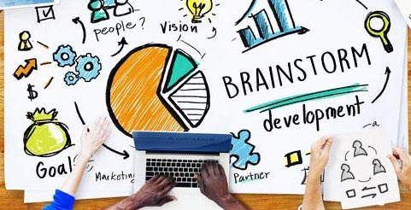
Ideas generation techniques
Kick back, allow your imagination
free rein and go idea hunting!

Slide 20
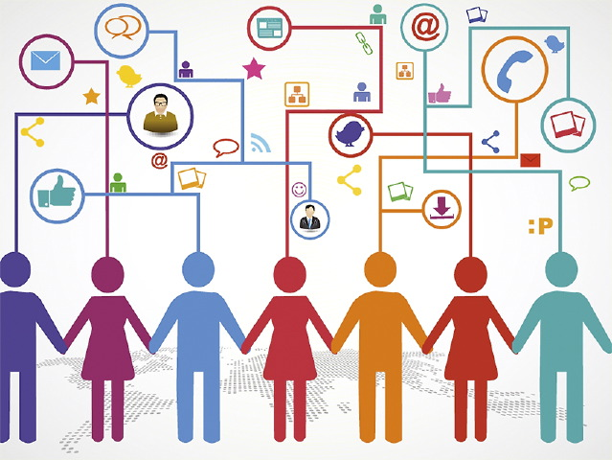
Let us let identify the Social Problems in Bangladesh that can be solved through the use of ICT!

Slide 21
Ek Taka Meal https://onetakameal.org/about
WHO WE ARE
In Bangladesh, we throw away an unbelievable amount of perfectly edible food every day. At the same time, a growing number of Bangladeshi find themselves struggling to make ends meet. In the course of a year, around 3.6 million Bangladesh find themselves unable to afford enough food to feed themselves or their families. For more than 1 million of these people, this is not a one-off, but a regular occurrence. The reasons behind this are complicated, but the bottom line isn’t – in short: we throw good food away while people go hungry. That doesn’t make sense.
https://www.youtube.com/watch?v=KYy0lbkAF6Y&t=742s

Slide 22
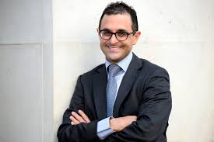
Do you know who this man is?

Slide 23
Arash Derambarsh
Being informed of the huge pile of food expired and dumped in the cities by supermarkets and people, he has tried to give the food that is still usable to the poor. Arash Derambarsh successfully gathered 21,000 signatures, with the help of his group, to bring a bill to the parliament. Eventually his bill was passed, requiring supermarkets that are larger than 400 square meters to give usable expired food to the poor or a fertilizer company or for animal food, instead of dumping it. Schools are also required to train children to consume food in the right way.
Source: https://en.wikipedia.org/wiki/Arash_Derambarsh

Slide 24
Man who forced French supermarkets to donate food wants to take law global
https://www.theguardian.com/world/2015/may/25/french-supermarkets-donate-food-waste-global-law-campaign
https://www.youtube.com/watch?v=U3-PR2rDgd4

Slide 25
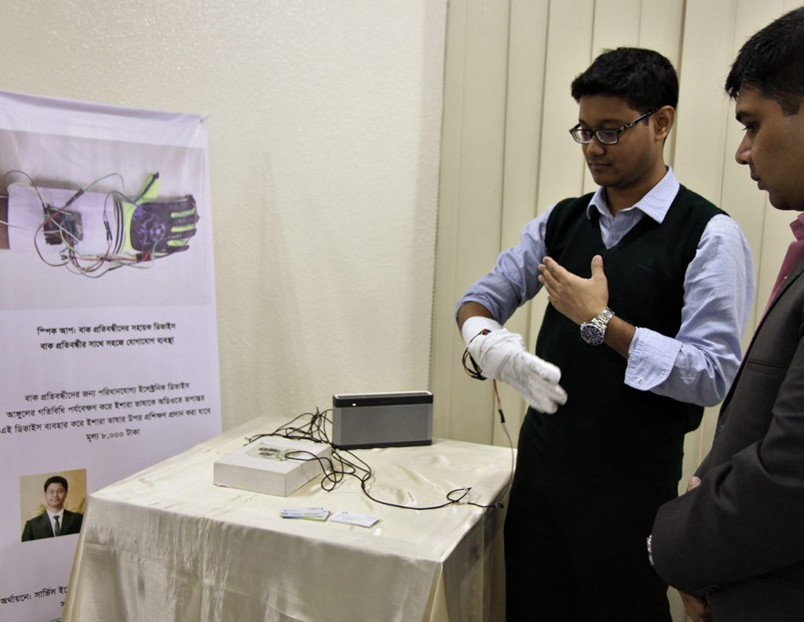
Innovation Lab a2i
https://a2i.gov.bd/innovation-lab/

Slide 26


Finding the right business idea is crucial. The right business idea is one which is viable, sustainable and suited to the business owner(s).

Slide 27
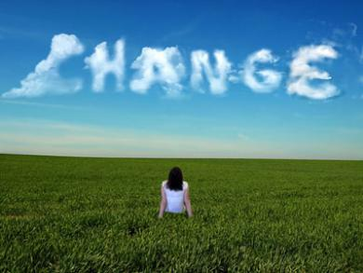
Draw your Business Vision!

Slide 28
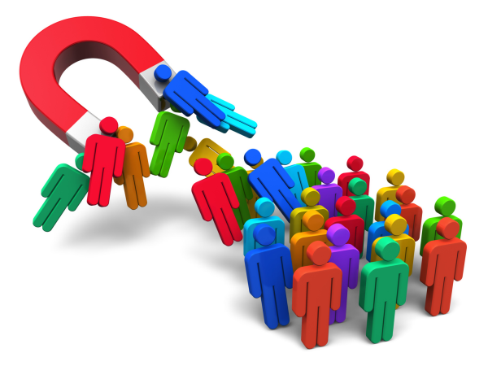
Create your Customers’ Profile!

Slide 29
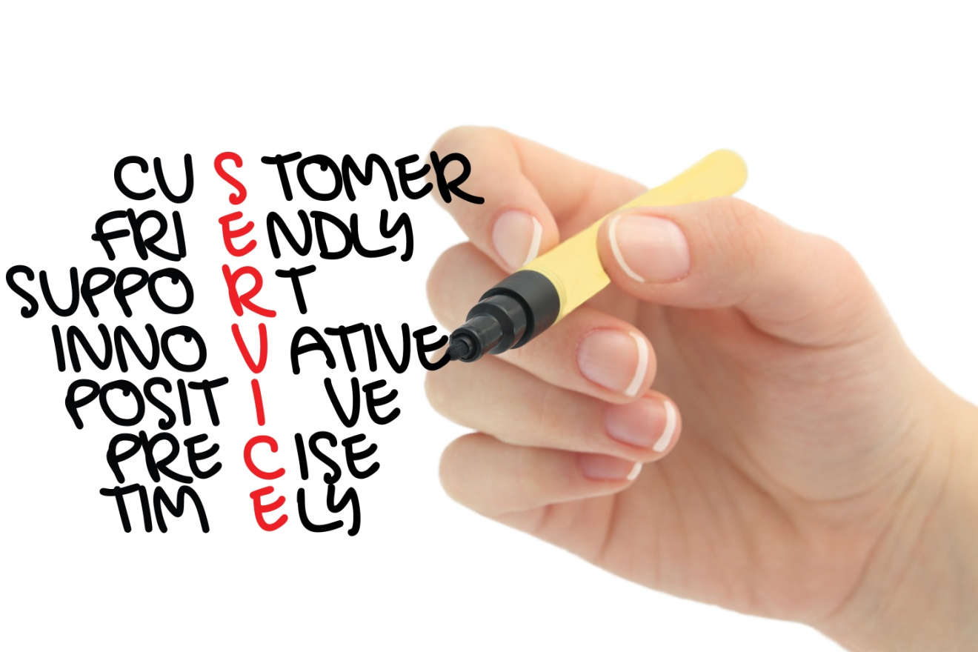
Does the idea match what consumers want today?
The Drivers – key functionalities
Wellness
Indulgence
Convenience
Value
Ethnicity
Demographics

Slide 30
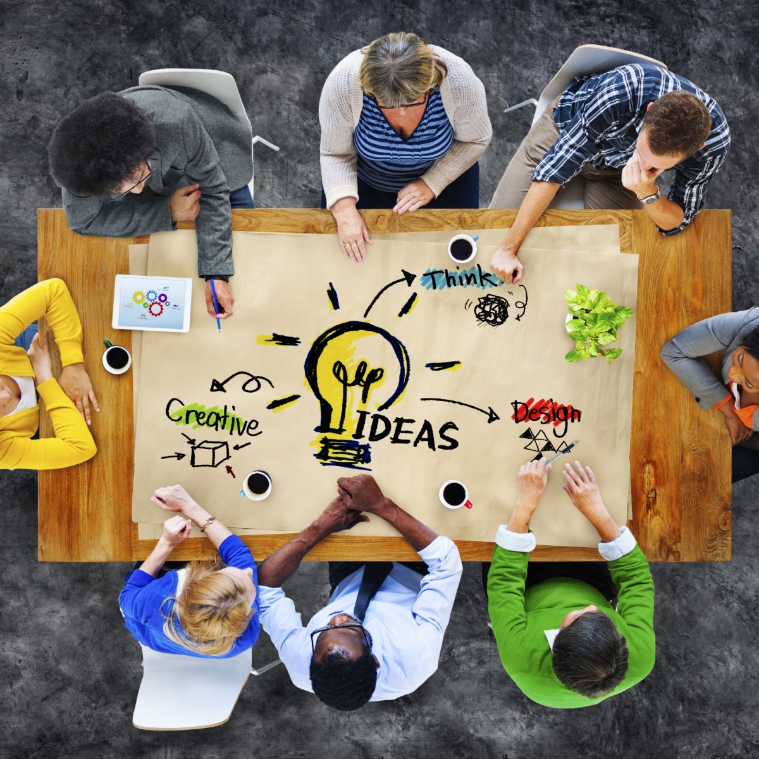
Develop a basic operational model!

Slide 31
Human-Centered Service Design
https://www.ideou.com/products/human-centered-service-design?fbclid=IwAR3HpDEFKfVsbQDFSvCUMXtYJfVIyZD9wYDhhiJLqWM2-dP1tTJubYaTLP4

Slide 32
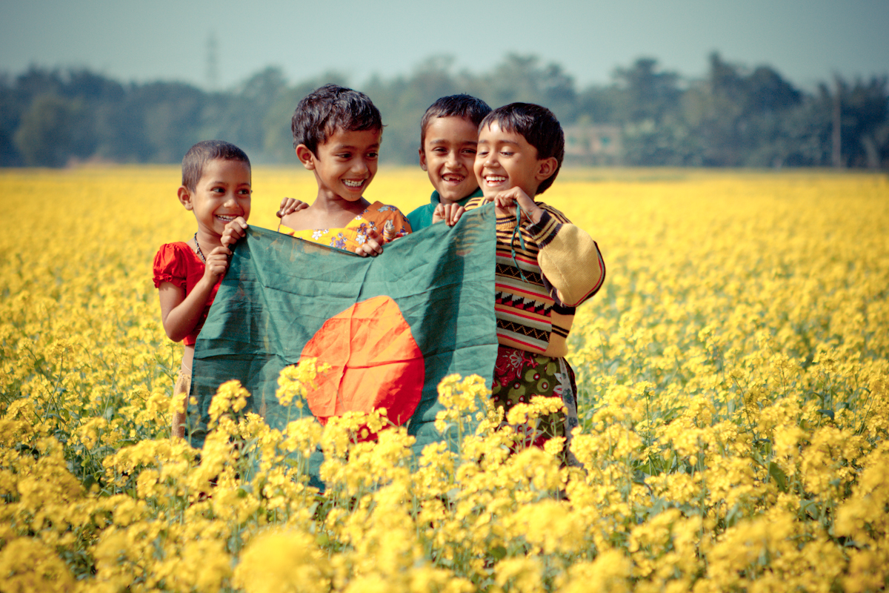
Visioning for the future of Bangladesh

